Slide 1
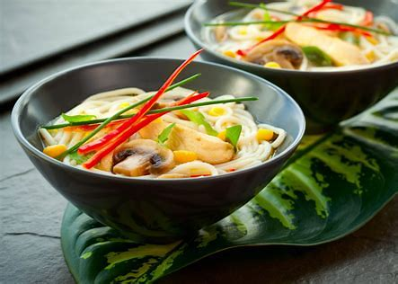
S27: Harnessing Traditional Chinese Medicine for Oncology: Integrating Dietary and Herbal Therapies in Supporting Cancer Treatment and Survivorship
Michelle Loy MD, Dip ABOIM, DipABLM, DABMA
Jennifer Ashby DAOM, LAc
John Chen PharmD, PhD, OMD, LAc

Slide 2
DISCLOSURES
Michelle Loy – None
Jennifer Ashby – None
John Chen – Owner of Art of Medicine Press, Consultant of Evergreen Herbs

Slide 3
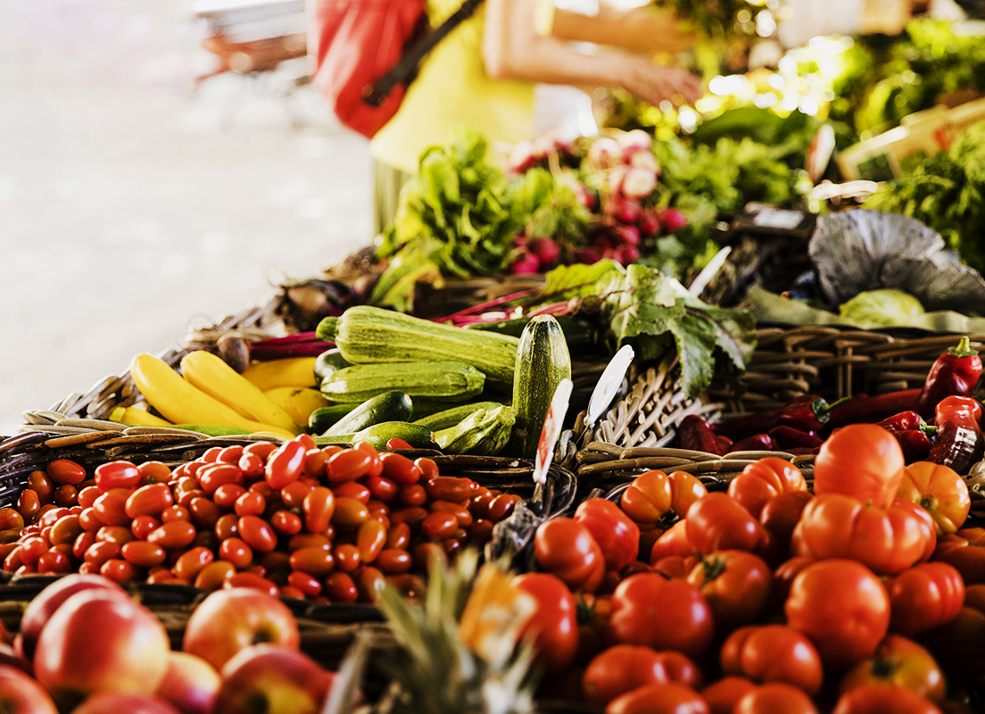
Agenda
Introduce principles of TCM dietary and herbal therapy and apply to clinical practice
Describe Bao He Wan Formula’s Role in GI cancer and oncology treatment side effects
Discuss the current research and clinical application of the traditional formula Huang Qing Tang
Discuss proper use of herbal formulas and provide resources for further education.
Herbal Therapy Illustration Table
Notes:
Bao3He2Wan2
Huang2Qing2Tang1

Slide 4
01
Introduction to TCM Dietary and Herbal Therapy

Slide 5
Introduction to TCM Dietary and Herbal Therapy
Michelle Loy, MD, DipABOIM, DipABLM, DABMA,
Weill Cornell Medicine/New York Presbyterian Hospital
03.06.2025

Slide 6
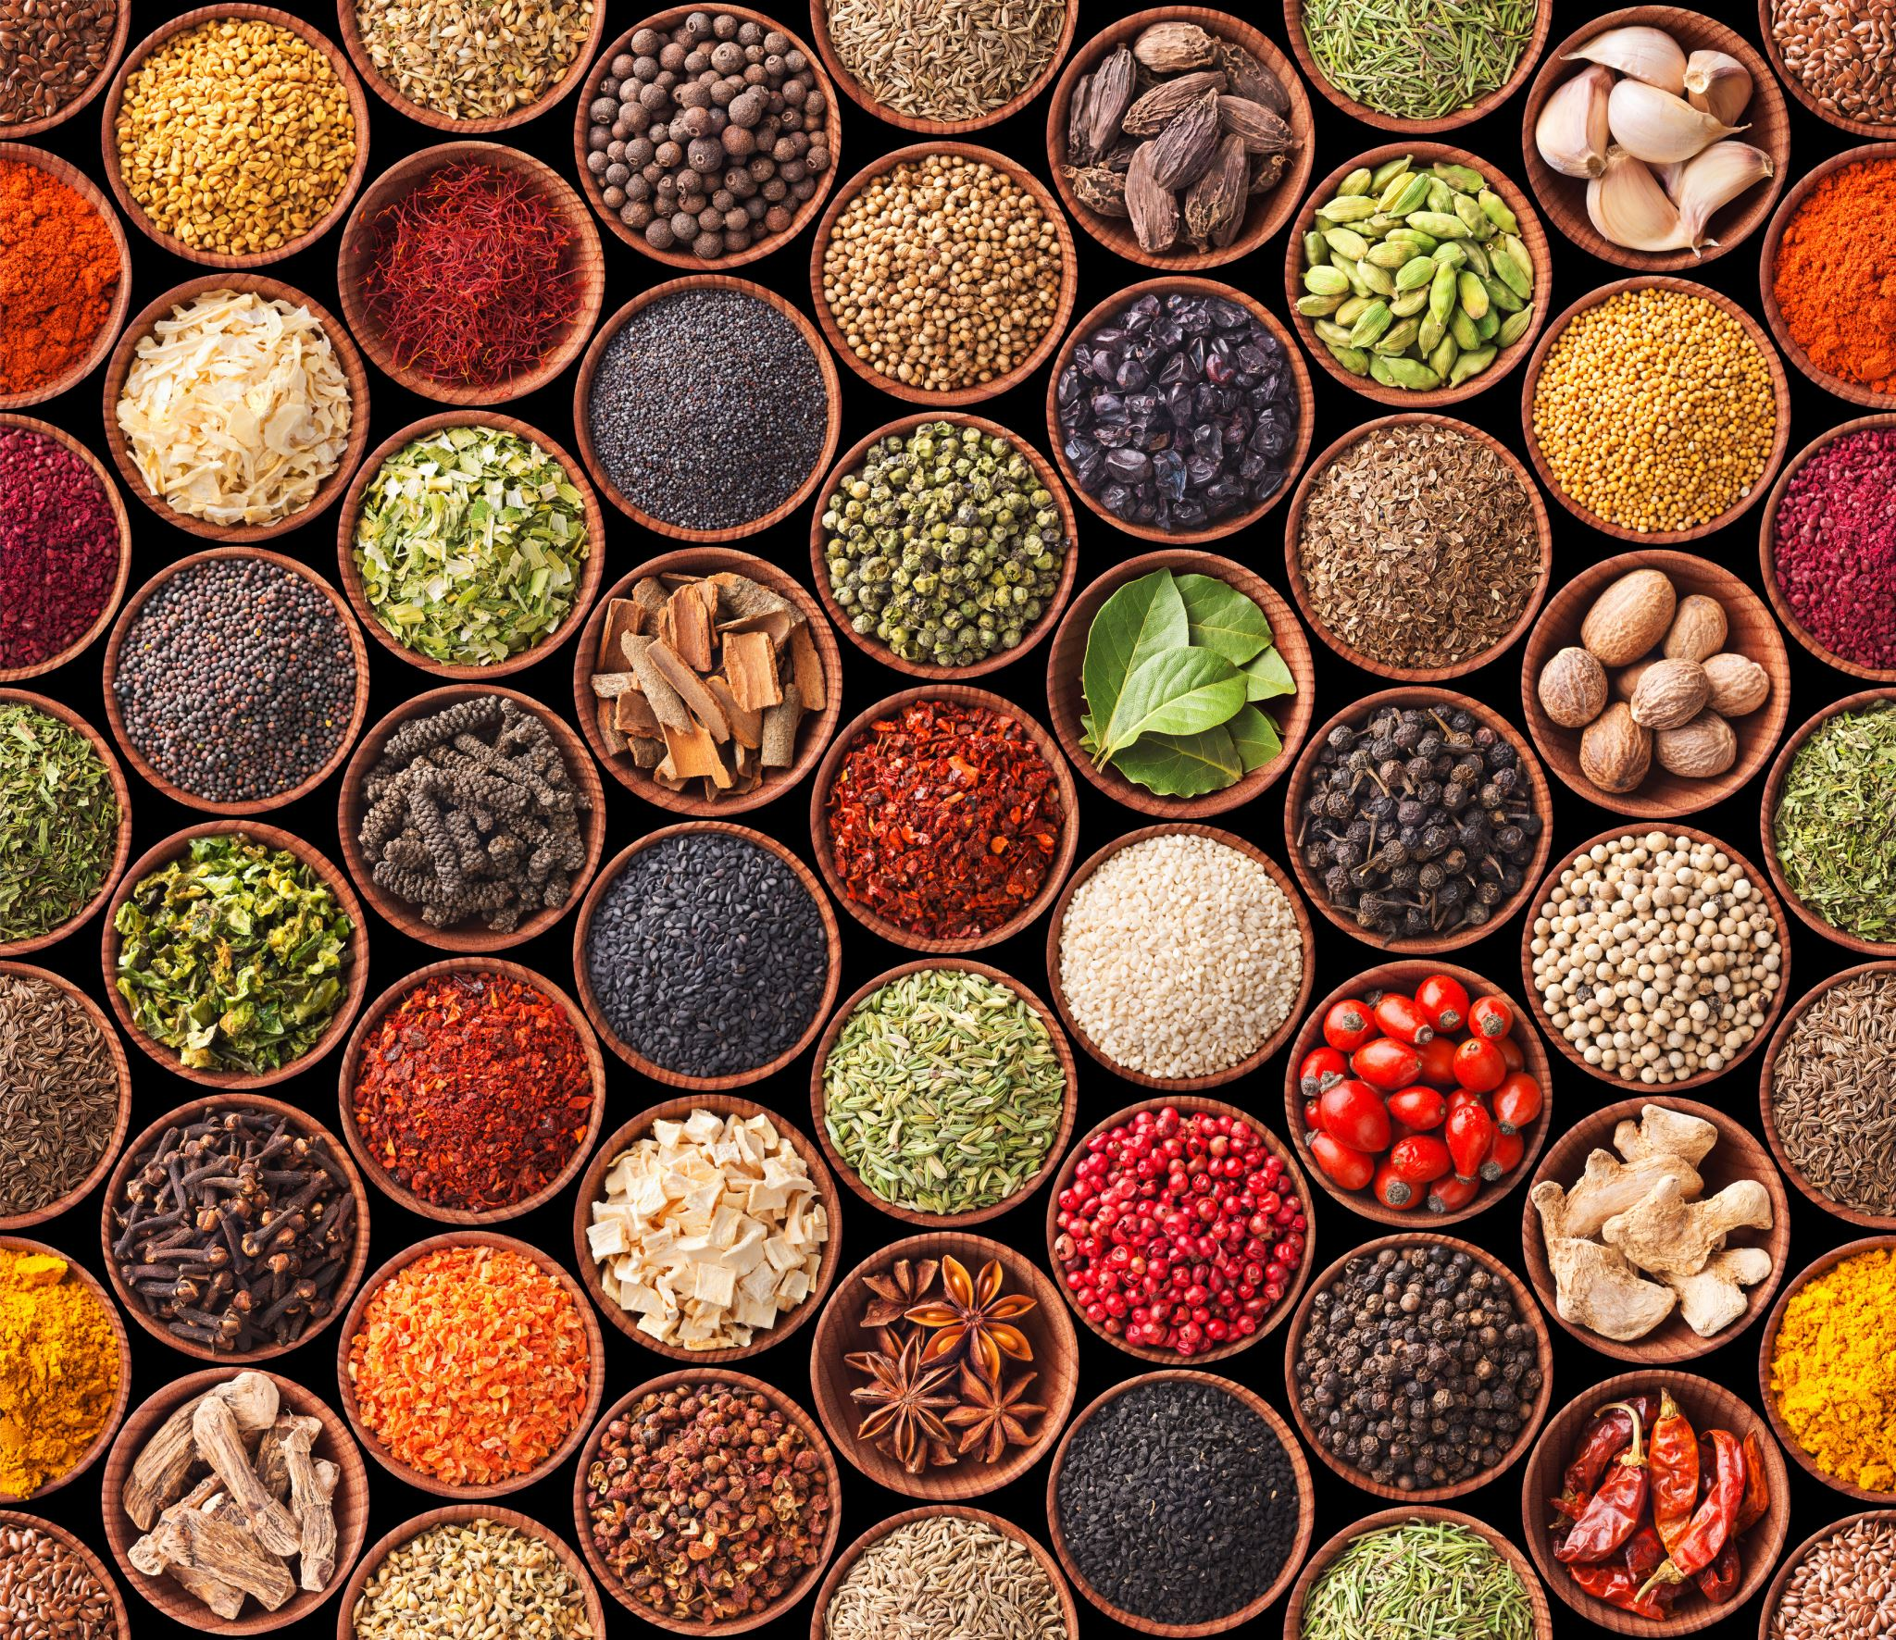
5 Principles and Practices of 5 Element TCM Dietary Therapy
1. FOUR TCM FOOD ENERGETICS 食物特性
5 Thermal Natures
5 Flavors
4 Food Qi Movements
Meridian Affiliation
2. TCM HERBALISM 中草药
3. SEASONALITY 应季而食
4. INDIVIDUAL BODY CONSTITUTION AND
CONDITIONS 因人而异
5. ENJOYMENT AND FLEXIBILITY 美观美味
Notes:
食物特性
shí wù tè xìng
应季而食
yīng jì ér shí
因人而异
yīn rén ér yì
美观美味
měi guān měi wèi

Slide 7
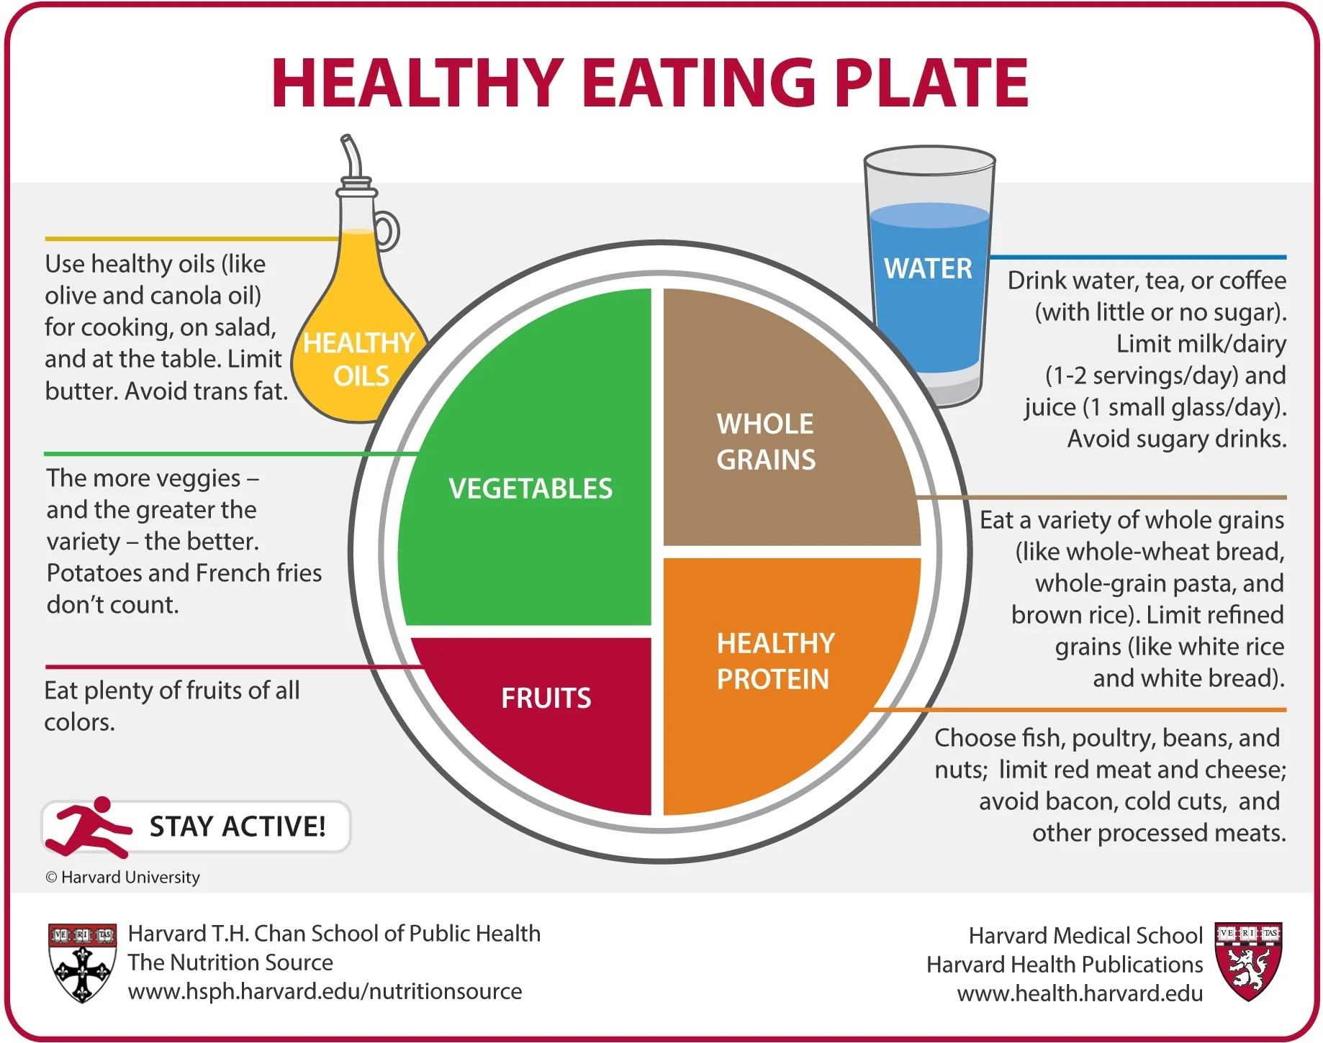
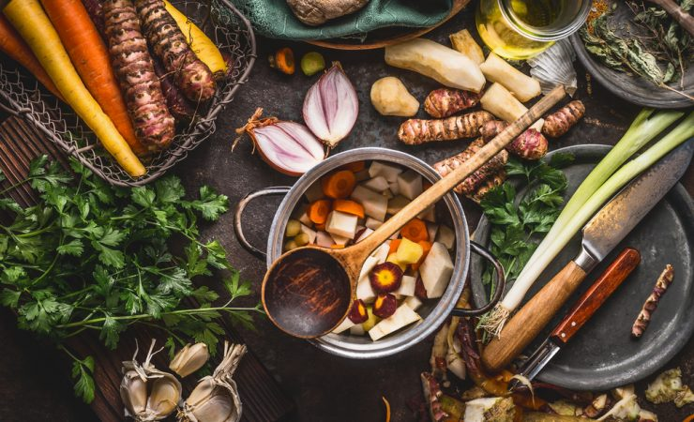
Integrate TCM Dietary Therapy with Conventional Model
Notes:
Can use conventional western dietary therapy (macro/micro nutrients, evidence based research, fruits, vegetables, grains, protein, dairy, eliminating obstacles to cure like trans fats) and layer on chinese dietary therapy (energetics) - same whole foods, macros, but also the thermal nature of the food (warming/cooling/neutral) and flavor (therapeutic role of sweet sour, salty pungent bitter,...) and eating seasonally

Slide 8
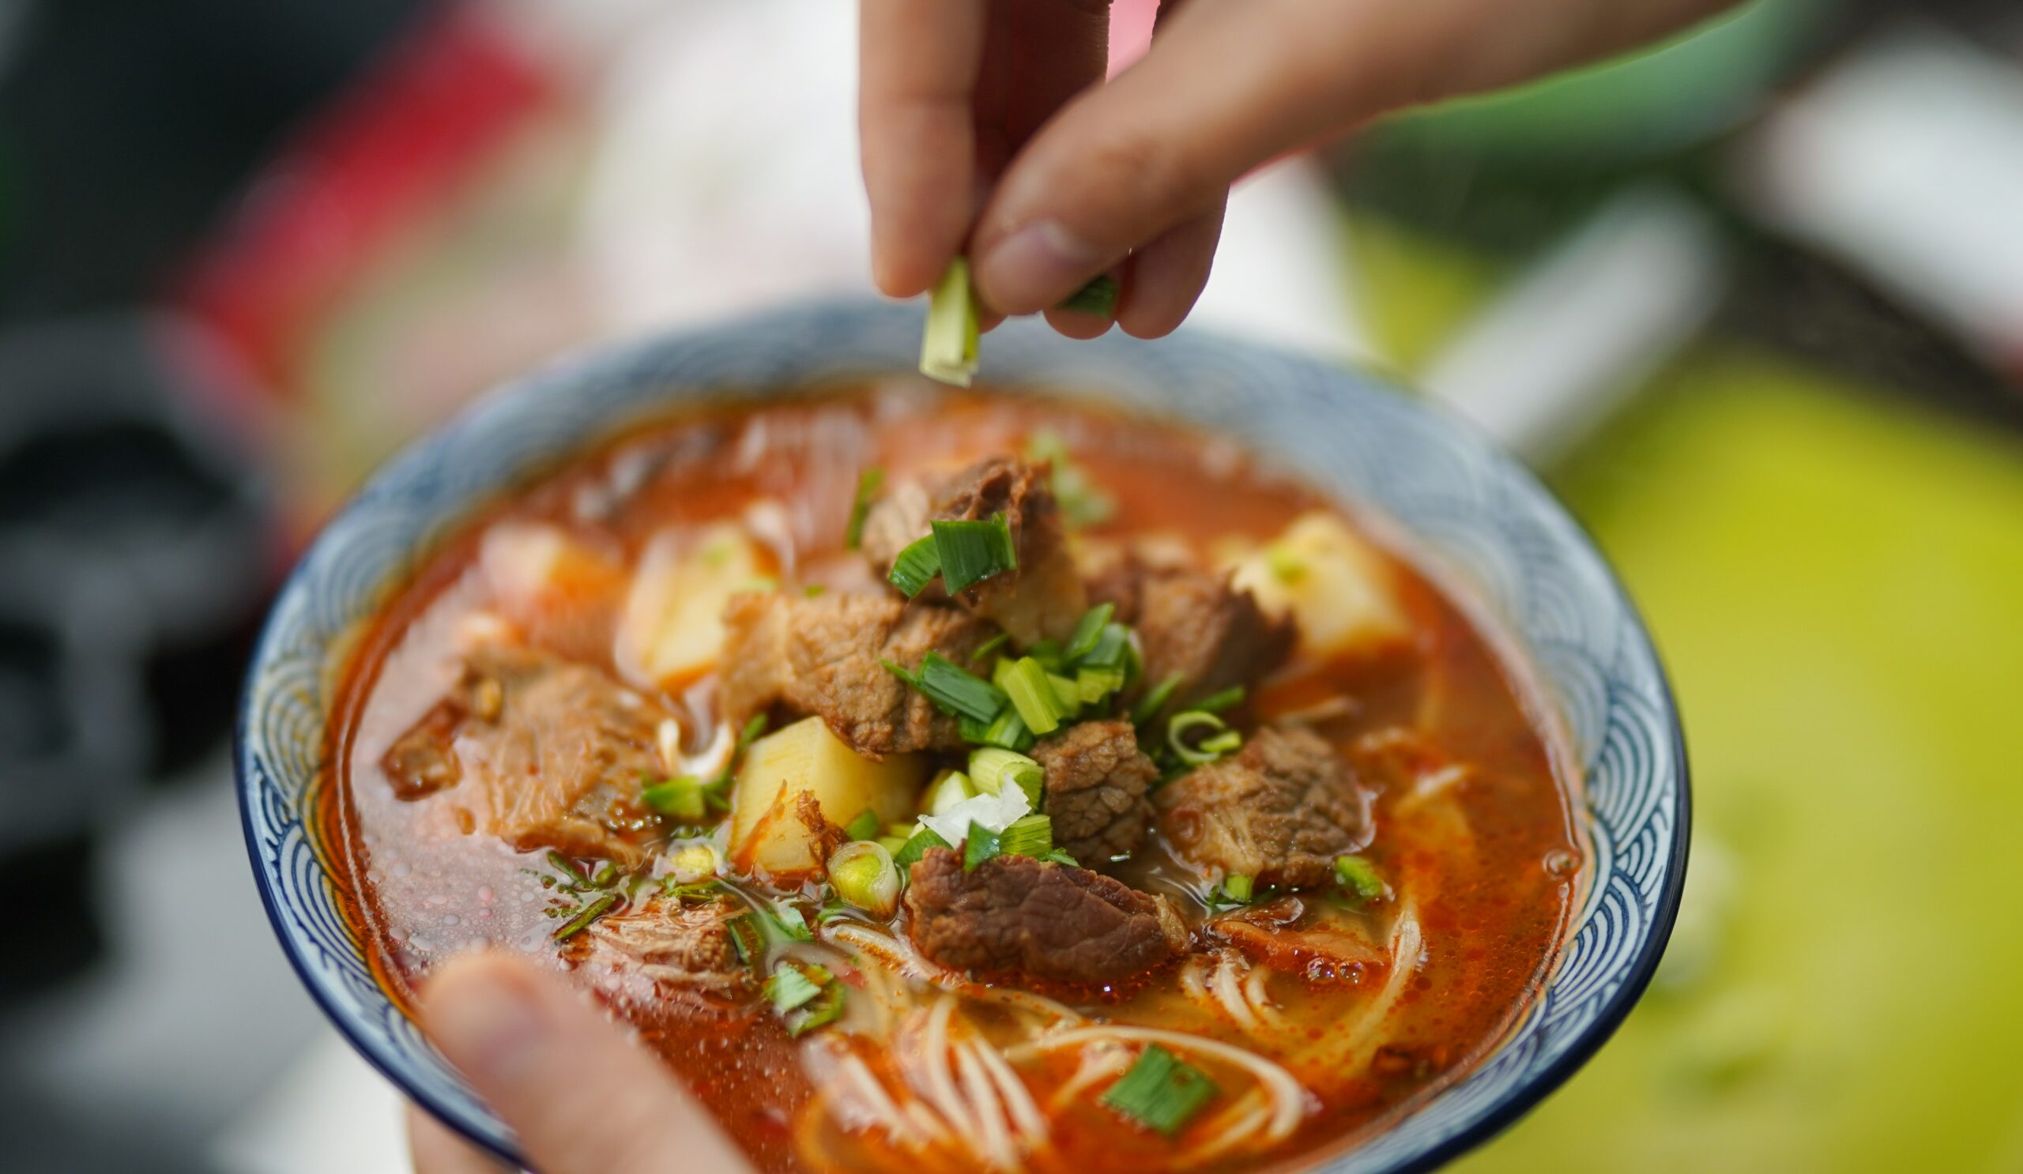
What TCM Dietary Therapy Adds
Utilize Thermal Nature of Food
Five Flavors and Therapeutic Actions
Seasonal Based Eating and Activity
Honoring individual constitution, stage in life, season/climate to promote balance and healing.

Slide 9
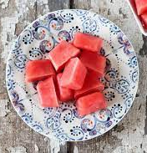
Food Energetics
Western Dietetics :46 calories, 0.9g protein, 11g carbohydrate, 0.6g fiber, 9g sugar, 0.2g fat, 170mg potassium, 20% DV vitamin A, etc.
TCM nutrition: cold, a summer or late summer fruit, sweet, heart/stomach/bladder meridian, down-bearing in nature.
Notes:
Listen to your body – not override your intuition – other ways to eat veg in winter besides salad -

Slide 10
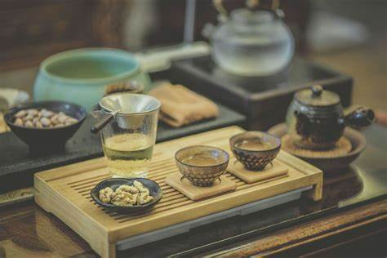
5 Thermal Natures: cold, cool, neutral, warm, hot

Slide 11
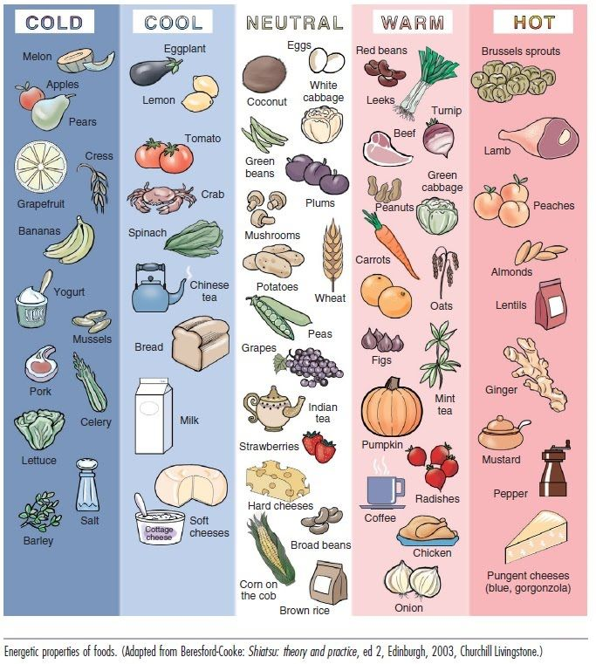
5 Thermal Natures
Not related to the physical temperature of the food, but to the sensation our body feels after consumption of certain food.
Use thermal nature/qi of our food (for strong shifts and to promote balance
Always need both cool and warm types of food... aim to stay around the fulcrum
Notes:
The thermal nature/qi of our food (warming vs cooling foods) for strong shifts and to also promote balance
Hot foods for those who are cold and sometimes weak - vivify the yang, wake up the fire in the body, help digestion, ignite the fireplace in body
Cold foods therapeutically clear heat (red face, agitation), detoxify, calm things down
Always need both types of food but be more intentional in use of foods, aim to stay around the fulcrum

Slide 12
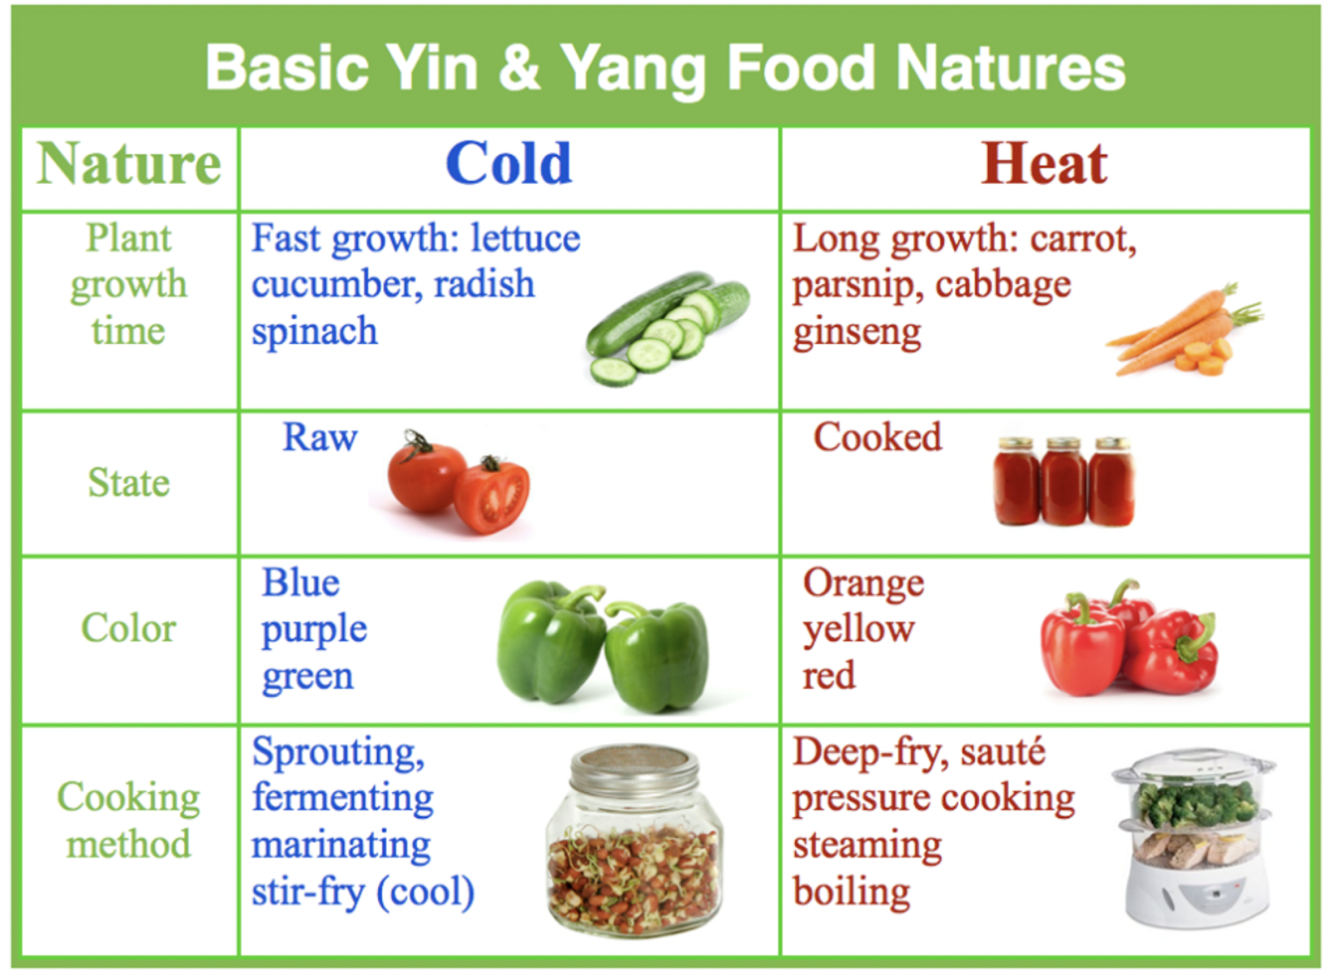
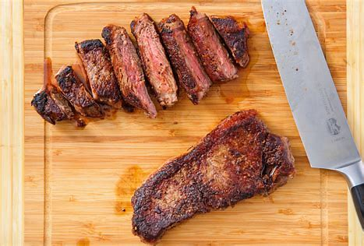
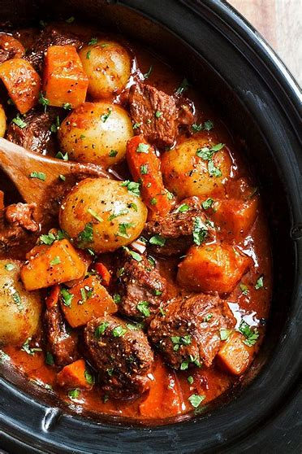
Using Thermal Nature of Food
Notes:
Explain how to utilize the thermal nature of food in ways specific to individual constitution, stage in life, and season to promote balance.
Can fry steak or beef stew
Due yao – gan cao can be fried or dry, ginger can be boiled or fried – changes the composition of the blend
If dry – maybe not roast/fry as much – steam, boil
https://www.sciencedirect.com/science/article/pii/S2666154320300247
Thermal nature may be Zn etc
Ginger is warming (even if served cold with sushi) and bamboo shoots are cooling (even served warm in stir fry)
5 Thermal Natures: All foods are assigned to a thermal nature in TCM:cold, cool, neutral, warm, hot. Note that it is not related to the physical temperature of the food, but to the sensation our body feels after consumption of certain food. For example, watermelon is cold, cucumber is cool, potato is neutral, beef is warm, and chili is hot.

Slide 13
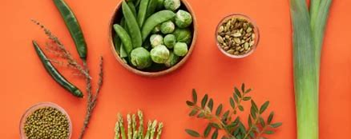
5 Flavors: sweet, spicy ,salty, bitter, sour

Slide 14
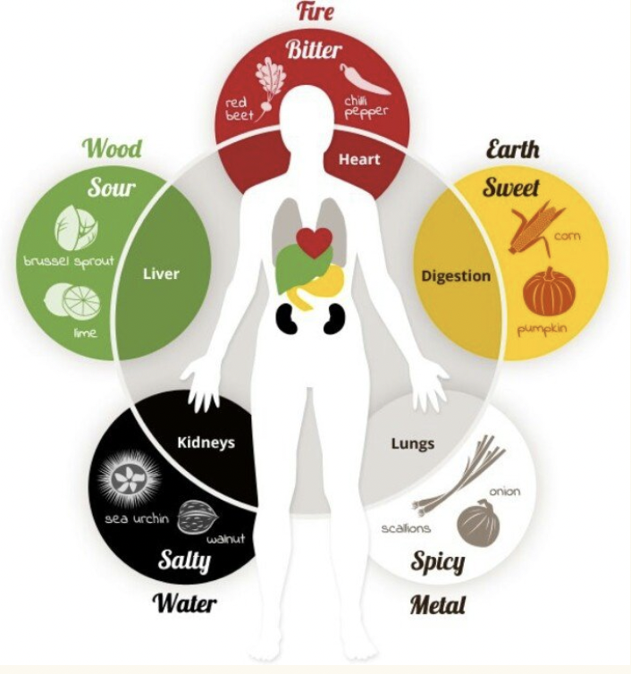
Harnessing the 5 Healing Flavors
Each food and herb is associated with a flavor, which implies certain actions on our body.
Sweet: tonify (similar to strengthening), moistens, calms
Acrid: disperses, invigorates, warms
Salty: cools, softens, loosens
Sour: astringes, preserves
Bitter: dries, hardens, cools
Notes:
Describe the five healing flavors of food and their therapeutic actions.
The 5 flavors in Chinese medicine exists in the food we eat as well as the herbs we may take.
Chinese medicine offers us a way to understand food and its healing capacity. One of the most important elements is the therapeutic effect that a flavor of a food has. The action and the energy a flavor has on us is not simply the pleasure of taste but the action it has on our body.

Slide 15
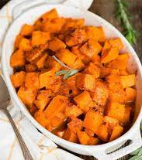
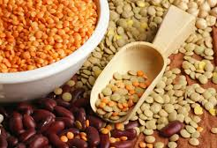
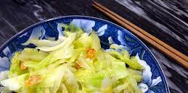
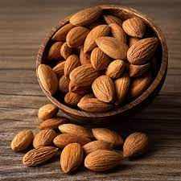
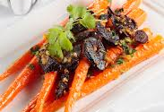
Sweet Flavor Foods in Chinese Medicine
Actions: Ascending, harmonizing, relaxing, yin-building, fluid building for thin-dry weak people
Indications: Stress, tension, nervousness, weak digestion, older and frail thin people
Caution: Overweight, sluggish, damp signs
Notes:
thermally neutral, nourishes and calm, eases the liver (meat (beef) is sweet, carrots, snap peas, grains, beans, nuts, seeds), important for young children developing the digestive and immune system - good quality of sweet food, not sugar.

Slide 16
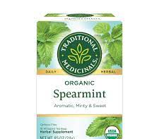
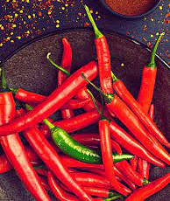
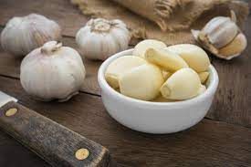
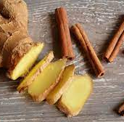
Pungent (Spicy) Flavor Foods
Actions: Disperses, expands, stimulates circulation, ascending and outward direction
Indications: Digestion, common cold protection, induce sweat, increase energy, kill parasites
Caution: weak, thin, dry or heat signs in body
Notes:
alliums, garlic, onion, chive, peppermint - movements is up and out, helps disperse cold, heat. Aromatics (spices in kitchen cabinet) - therapeutic. All ancestors knew about them. If add cinnamon to rice - enhances the sweetness of rice and adds depth of flavor, aromatic pungent warming spice (good for kidneys), basil good for digestive system adds different flavor to rice. Aromatic warms center of body, pungent moves things out

Slide 17
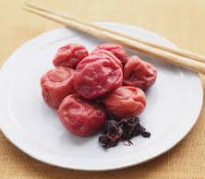
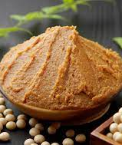
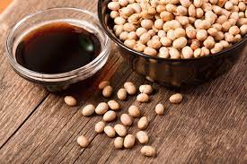
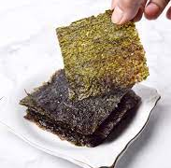
Salty Flavor Foods in Chinese Medicine
Action: Cooling, descending, moistening, reduces stiffness, detoxifies, purges bowel
Indications: Swollen lymph nodes, constipation, sore muscles, sore throat, no appetite
Caution: Do not overdo if sluggish, overweight, edema, high blood pressure, signs of damp
Notes:
-cooling, yin, support kidney function (pork, duck, tamari), millet
dries dampness, moistens dryness, - miso, tamari, sea vegetables, rich in minerals ca, mg, fe

Slide 18
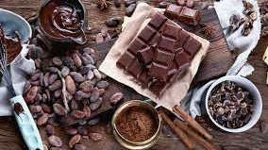
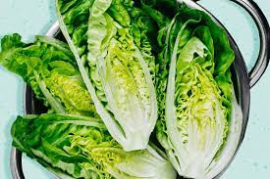
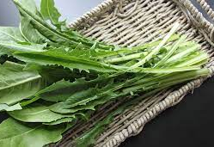
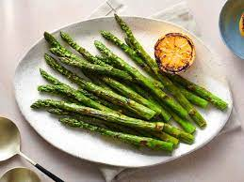
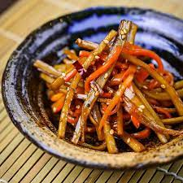
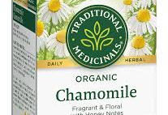
Bitter Flavor Foods in Chinese Medicine
Actions: Cooling, descending, clears heat, dries fluid, drain dampness, induce bowel movement
Indications: Inflammation, infection, high cholesterol, weight, high blood pressure, candida, excess mucus, skin eruption, swelling, constipation
Caution: weak, thin deficient, dry, or cold
Notes:
Cold , yin, detoxify ,clear heat, purges and drains downward - bitter melon purely bitter - brings down cholesterol, diabetes, cooked with shrimp, pork or black bean, tomato/miso to mitigate bitter, coffee, chocolate, beer, tea
Escarole, chicory, hops, yellow grapefruit, artichoke, white asparagus, cardoon, raw olive (brining modifies palatability)

Slide 19
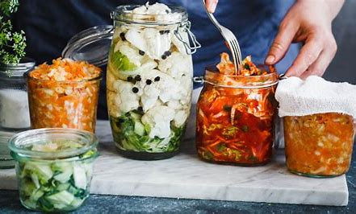
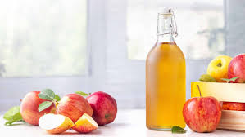
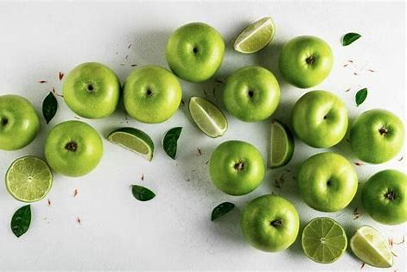
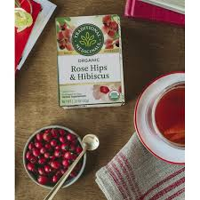
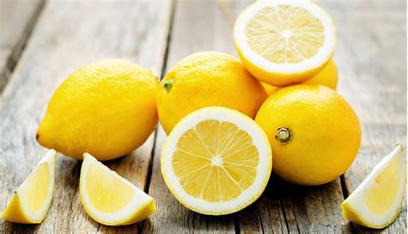
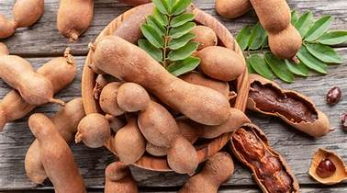
Sour Flavor Foods in Chinese Medicine
Actions: Cooling, contracting, astringent, preventing fluid leakage
Indications: Incontinence, excess sweating, diarrhea, excess vaginal discharge or seminal emission
Caution: Limit if there is constipation or tendon/joint problems
Notes:
Sour – tamarind, berries, oranges, yin and cooling, moistening, hydrating, activates. Good in summer and autumn (hibiscus, pears, apples)

Slide 20
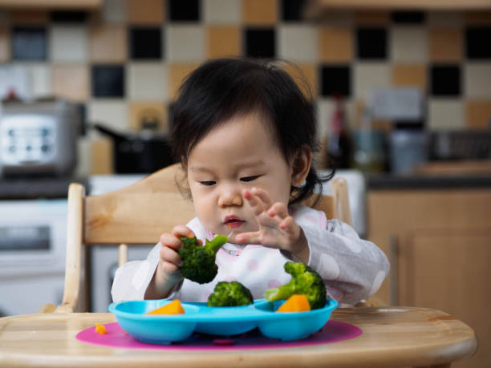
Eat all 5 tastes as repeated exploration influences acceptance
Repeating exposure can influence acceptance, particularly in infancy. Study with mothers of 7 month olds –By 8th repetition, intake of liked and unliked vegetable were identical (Borowitz 2021)
Infants who are offered different textures while beginning to eat solids, are more willing to eat and enjoy chopped or chunky foods by age 1, and more likely to eat variety of fruits and vegetables by age 7.
Notes:
Study with mothers of 7 month olds – asked to identify vegetable infant disliked and offer that vegetable on alternative days for 16 days and offer well liked vegetable (often carrots, sweet potato, squash) on other days. By 8th repetition, intake of liked and unliked were identical (Borowitz 2021

Slide 21
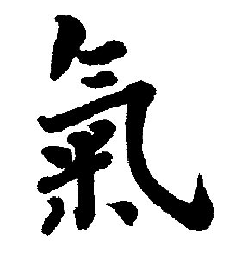
4 Qi Movements

Slide 22
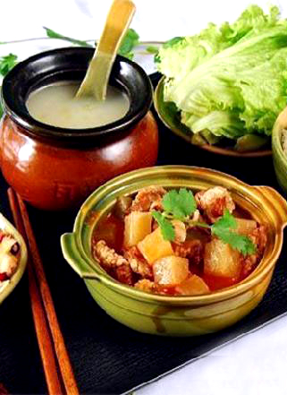
Upward, Downward, Inward, Outward
Food can influence how Qi moves throughout our body.
Upwards: hot/warm, yang-replenishing foods, usually spicy or sweet
Downwards: cool/cold, yin-nourishing foods, usually salty or bitter
Inwards: sour foods, usually sour (think about a baby’s “sour” face after tasting a lemon)
Outwards: acrid yang foods, usually warming spices
Notes:
The movement of Qi influences how we feel and how our organs function.

Slide 23
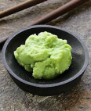
The Wasabi Challenge
Wasabi (Japanese horseradish) is warm and very
pungent.
The burst of heat and energy you experience in your nose and head when you eat a bit too much
is a clear experience of this upward and outward movement of Qi from PUNGENT foods.

Slide 24
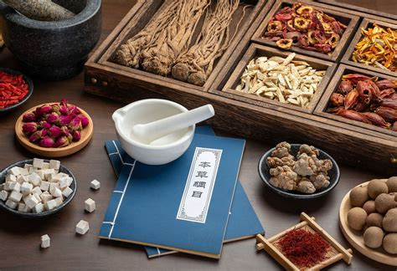
MERIDIAN AFFILIATION

Slide 25
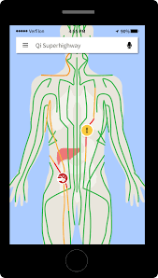
Meridian Affiliation
Each food can be associated with several meridians.
Spleen/Stomach: sweet flavor, late summer food
Lung/Large Intestine: acrid or spicy flavor, autumn food
Kidney/Bladder: salty flavor, winter food
Liver/Gallbladder: sour, flavor spring foods
Heart/Small Intestine: bitter flavor, summer foods

Slide 26
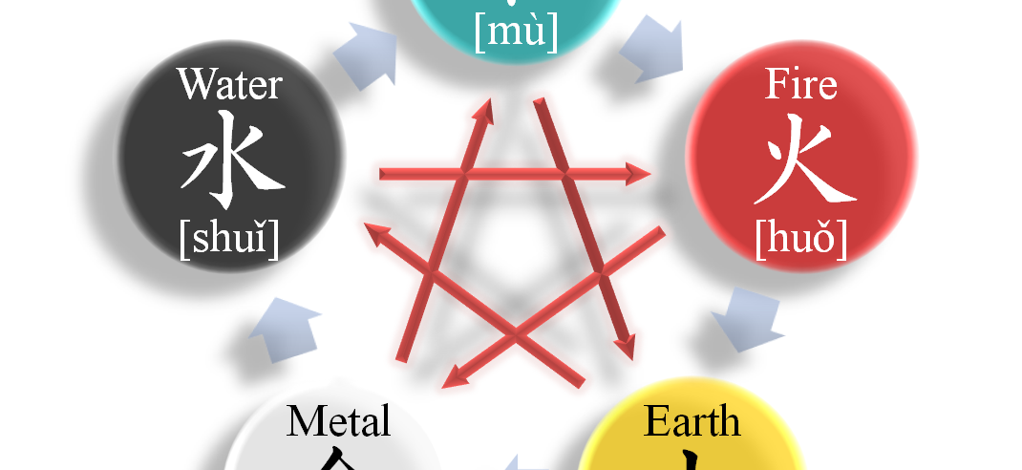
PUTTING IT ALL TOGETHER: FIVE ELEMENTS

Slide 27
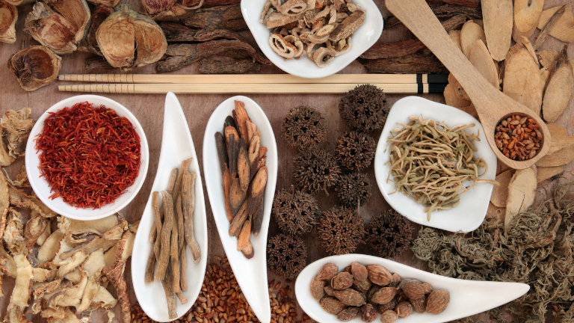
TCM HERBALISM
中草药

Slide 28
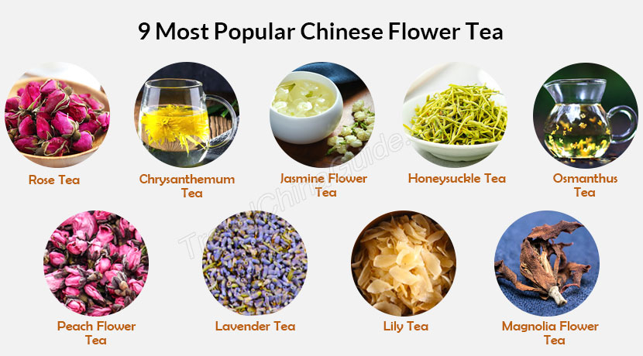
TCM Food Therapy vs TCM Herbalism
TCM Food Therapy is not the same as TCM herbalism.
TCM herbalism focuses on potent herbal decoctions vs. long-term, diet-based approach.
Think - herbal decoctions as “pharmaceutical drug” and food therapy as “superfoods,”
Similarities: use of 111 herbs (药食同源 food-medicine herbs), principles of combination and preparation method
Ex: chrysanthemum, ginger, hemp seed are food-medicinal herbs that are used in both areas
Ex: Curcumin – dosing of food vs medicine (potential CYP450 inhibitor, increasing effect of Taxotere)
Many herbals are also made of food (ex: bao he wan).
Think of TCM dietary and herbalism as a continuum?
Notes:
Take herbs separately by 2 hours (pharmacokinetic interactions on absorption, distribution, metabolism, elimination)
CYP450 induction ex; SJW – decreased therapeutic effect on other meds/drugs/herbs - OCP/Sz meds/antibiotic/steroids, etoh – takes about 1-2 months before effect observed (Others ku shen, gen gan)
CYP 450 inhibitor ex curcuim – increased therapeutic action of Taxotere, prograf, antifungal, antiulcer, grapefruit– takes about 2 weeks before effect observed ) (Others – flos magnolia, gan cao, dan shen )
Monitor pt carefully, adjust dosage of herbs as needed, select another herb w/o intreaction

Slide 29
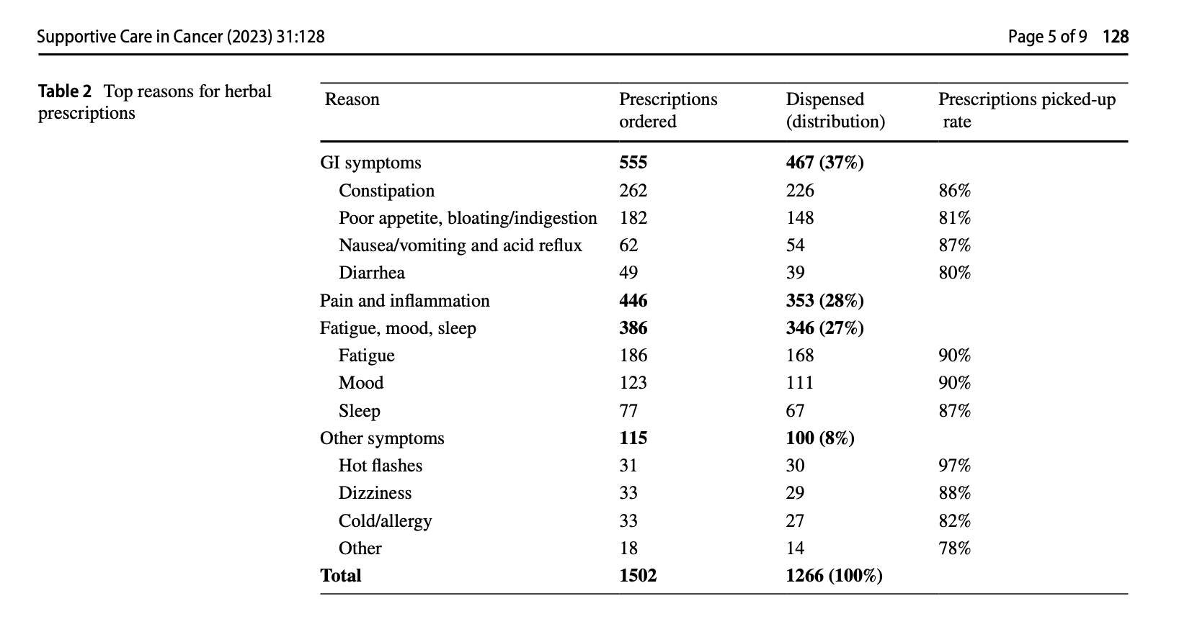
Hou et al 2023
Notes:
https://doi.org/10.1007/s00520-023-07577-x
Supportive Care in Cancer (Hou et al 2023)

Slide 30
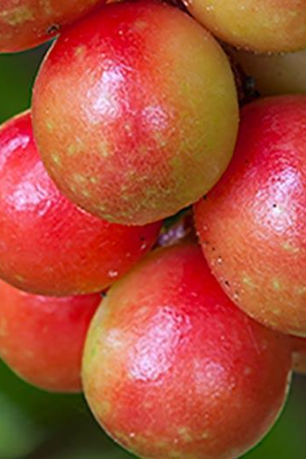
TCM Herbal Formulas
Mood: Xiao Yao San
Fatigue: Sheng Mai San/Bu Zhong Yi Qi Tang
Insomnia: Suan Zao Ren Tang/Tian Wang Bu Xin Dan
GI: Bao He Wan/Ban Xia Xie Xin Tang
Myelosuppression: Dang Gui Bu Xue Tang
Hot flash: Zhi Bai Di Huang Wan
Dizziness: Ling Gui Zhu Gan Tang
Constipation: Ma Zi Ren Wan
Diarrhea: Sheng Ling Bai Zhu San
Cough: Zhi Sou San
Immunity: Yu Ping Feng San
Notes:
(MSK Formulary)

Slide 31





TCM Herbal Therapy
TCM
Western
Teas
  Cook actual herbs
  Granules
Patented tablets
Steam bath
External/topical
Tinctures
Extractions
Purified single chemical

Slide 32

SEASONALITY
应季而食

Slide 33

Notes:
Spring – more sweet & spicy, less pungent to regulate liver qi, less sour if liver overstimulated (more if need to detoxify)
Summer – more salty & cooling, to help regulate heart qi (excess sweating), less bitter (drying out) but can also be cooling
Autumn – more sweet (for preparation), sour (astringent, to keep moisture), less spicy (perspiring)
Winter – more bitter & warming, less salty (to reduce workload on kidney); enrich yin through appropriate fats and high protein foods

Slide 34
INDIVIDUAL BODY CONSTITUTION &
AND CONDITIONS
因人而异

Slide 35



INDIVIDUAL BODY CONSTITUTION AND CONDITIONS 因人而异
TCM nutrition is personalized, unlike most diet trends.
It encourages you to eat according to your own body constitution and health conditions, rather than merely following the recommended daily value of protein and calories, and fat.
There are 9 body constitutions in TCM, and each deserves a slightly different approach to diet and lifestyle

Slide 36
ENJOYMENT &
FLEXIBILITY
美观美味

Slide 37

ENJOYMENT AND FLEXIBILITY 美观美味
Not about restriction; rather a flexible system that allows you to consume most of the things with moderation
Encourages more of certain foods during certain seasons to address imbalances, and to limit certain foods that likely contribute to disharmonies.
The principles and herbs are very easily applicable for cuisines all over the world.
Ancient TCM recipe books state medicinal dishes should taste and look appetizing.
Enjoy the process of learning about your body.
Notes:
Cut down works

Slide 38



Principle of Yang Shen – Health Nurturing
Tune into your body’s unique wisdom to make better choices…Avoid being driven by trends.
Notes:
Don’t demonize pasta over quinoa – similar glycemic load, protein
https://draxe.com/nutrition/is-pasta-healthy/
Full fat Greek Yogurt for Breakfast?
Raw kale salad massage with lemon juice for lunch?
Ginger Shots and Cinnamon for snack? - can cause mouth ulcers, tongue sores, sore throat – signs of overheating in TCM
If Dressing for salad – add ginger to warm, or take out of icebox

Slide 39


Chinese Proverbs on Eating
Pursue harmony between food elements
(不得其醬，不食）
Eat fresh and local （不時，不食）
Know the origin of your food 食饐而餲，鱼馁而肉败，不食 . )
民以食為天 - “To the people, food is heaven” (Han Dynasty)
He that takes medicine and neglects diet, wastes the skills of the physician.
Notes:
bù 不 dé 得 qí 其 jiàng 醬 ， bù 不 shí 食
shí 食 yì 饐 ér 而 ài 餲 ， yú 鱼 něi 馁 ér 而 ròu 肉 bài 败 ， bù 不 shí 食 .
'Mín yǐ shí wéi tiān'
When food is fresh, i.e., just harvested fruit, or scallions and bok choy, or freshly-ground wheat,
the Chinese believe these foods have more Qi (in this context Qi means "life force or vitality.")

Slide 40
Applicable, Affordable, Accessible

Slide 42







Living Well With and After Cancer
Loy MH, Prisco L, Parikh C. Implementation of Virtual Integrative Oncology Shared Medical Appointment Series (VIOSMAS) Within Mixed Diagnosis Population. Integr Cancer Ther. 2024 Jan-Dec;23. PMID: 38243739

Slide 43

Herbs/Botanical Menu in 1:1 Consultations
Nausea: ginger
Constipation: ginger, flax, triphala
Gastroparesis: ginger
Fast Transit: peppermint, caraway
Cramping Diarrhea: chamomile, apple pectin, tea
Mixed constipation/diarrhea: psyllium
Poor Appetite/digestion: bitters -artichoke, dandelion, orange peel,
Excess Digestive Gas: angelica, anise, caraway, chamomile, fennel, ginger, peppermint
Stress: adaptogens (cordyceps, holy basil, schisandra)
Anxiety/Insomnia: nervines (chamomile, kava, lavender, lemon balm, passionflower)
Skin irritation: emollients and demulcents (slippery elm, marshmallow)
Sweating: sage (astringent), coriander

Slide 44


Slide 45


From Herbal Apothecary to
Gourmet Grocery Store
Notes:
5 Spice (or 13 spice) Powder (previously only found in herbal apothecary)

Slide 46

Cinnamon
Indications
  Blood sugar, cramps/dysmenorrhea
  Tooth decay/halitosis
  Appetite stimulant, arthritis, inflammation, dyspepsia
Action
  Anti-oxidant, anti-inflammatory, immunomodulatory, anti-microbial, anti- tumor, anti-estrogen
Safety
  Safe when used in amounts used in foods
  Larger amounts: GI distress
  Allergic reactions, hepatotoxicity

Slide 47
Cinnamon (Cinnamomum verum, Cinnamomum cassia)
Cinnamomum verum (true cinnamon, Vietnamese, Ceylon): herbal, savory, not super sweet, crumbly, low in coumarin
Cinnamon burmannii (Korintje Cinnamon): most common in US, mild, friendly
Cinnamomum cassia (Saigon Cinnamon): quill bark – sweeter; contains coumarin
Cinnamonum loureiroi (Royal Cinnamon): super sweet and spicy
Notes:
Example of genus species dictacting function

Slide 48

Commonly Found TCM Food Therapy Ingredients
Ginger
Cinnamon
Scallions
Mint
Chysanthemum flowers
Mung bean
Watermelon
Adzuki beans
Hemp seeds
Dried Tangerine Peel
Star Anise
Turmeric
Goji berries (Wolfberries)
Chinese dates
Walnuts
Black Sesame seeds
Wood ear mushrooms
Pumpkin seeds
Garlic
Mulberry
Monk Fruit
Saffron
Notes:
Accessible and effective, found in modern grocery store
-Ginger. Yum! This warm herb is incredibly effective for nausea and vomiting. It’s frequently used by people undergoing chemotherapy to control nausea. Ginger can also stop a cough, and can fight off a cold in its early stages. The papery skin of the ginger root is used in Chinese medicine to drain edema (water swelling) and induce urination.
-Cinnamon is also a warm herb that can also help you fight off a cold. Its warming effects are helpful for joint pain that gets worse in the cold weather. Cinnamon has mild antibiotic and diuretic (drains water) effects.
-Scallions, when mixed with ginger in a warm broth, are perfect for the first stages of a cold. Scallions are hot enough to drain nasal congestion and to induce sweating, which often heads off a cold before it starts.
-Mint is a cool herb that works well for colds and flu that are accompanied by a fever, headache, cough and sore throat. Mint is also used to bring an early rash to the surface of the skin, so it can heal faster.
-Chrysanthemum flowers, which are usually found in tea is good for red, painful, dry eyes. It can help with blurry vision, tearing, and mild dizziness. There is some research that indicated this herb may be useful in lowering high blood pressure.
-Mung beans clear something called Summerheat, which is similar to heat exhaustion. Boil the beans and drink the water to get rid of that blah nauseous feeling you get on the hottest, most humid days of the summer.
-Watermelon is also great for Summerheat. In addition, it generates fluids and alleviates thirst.
-Aduki beans look like small pinto beans. They can be used to clear heat and drain dampness through urination. Dampness is a condition in which your body doesn’t metabolize fluids very well, and can cause problems like edema and urinary problems.
-While not usually found at the grocery store, hemp seeds are slightly oily and moistening, and are used in Chinese medicine for constipation. So don’t throw those seeds away!
-Dried tangerine peel sounds gross, but it is used as a digestive aid for bloating, belching, nausea, and vomiting. It is also effective for drying phlegm. Put small pieces (1/2 inch or so) into tea.
-Tumeric, which is found in the spice aisle of the grocery store, can be effective for lowering cholesterol.
-Chinese wolfberries, also know as Goji berries are getting a lot of attention in health food circles as a miracle food. In Chinese medicine, they’re used to nourish Kidney and Liver Yin, moisten the Lungs, especially when you have a chronic dry cough. Goji berries are also used for eye and vision problems.
-Chinese dates are very nourishing in nature. They’re used in Chinese medicine for overall weakness, shortness of breath, poor appetite, and for calming.
-You may think of walnuts as being the perfect chocolate chip cookie ingredient. However, walnuts also strengthen your Kidney and moisten your intestines. I recommend walnuts (not necessarily in cookies) to my patients who have constipation.
-Like walnuts, black sesame seeds also moisten your intestines are can be used for constipation. They also nourish your Kidney and Liver, and can help with blurred vision, tinnitus, and dizziness.
-Look in the fungi section of the store for wood ear mushrooms. They moisten your Lungs and are good for a chronic, dry cough. Eat them in stir fried dishes.
-Got parasites? Try pumpkin seeds. They’re used in Chinese medicine for tape worms and round worms.
-Garlic is also used for parasites, especially hook and pinworms. Its antimicrobial effects also make garlic a good choice for food poisoning from shellfish.
-Also found in the spice aisle, alum can be used as an external wash. For scabies, ringworm, damp and red rashes, and minor skin infections.
-Mulberry fruit looks a little like large black raspberries. While not found in all grocery stores, most will carry mulberries when they’re in season. They can be used to nourish Blood and Yin, as a way to treat dizziness, tinnitus, insomnia, premature graying of your hair, and constipation in the elderly. Mulberries make a great addition to a fruit compote, which when combined with other fruits, is moistening in nature.

Slide 49




Chinese Four Herbs Soup

Slide 50

Dr. Loy’s Immune-Boosting Broth
1 leek sliced thin
4 stalks celery chopped
1 shallot chopped
1 T fresh turmeric root (or 1 tsp dried)
1 tsp cinnamon
½ tsp cardamon
½ tsp cumin
4T olive oil or avocado oil (or omit)
1/2C chopped medicinal mushroom (shitake, maitake, enoki, oyster, etc)
2C chopped rainbow chard separated into stems and leaves (or dandelion, kale, bok choy)
1C red lentils
4 C bone broth or vegetable stock
2T chopped astralagus root (keep separate in muslin bag or tea ball)
1 burdock, chopped (optional)
Codonopsis (optional)
(Provided by Dr. Michelle Loy, adapted from Dr. Anne Kennard)
Or consider Shabu Shabu
Notes:
This immune boosting soup highlights mushrooms and astralagus, imparting a direct immunomodulatory effect, improving innate immunity when the system is down, and offering cancer-fighting properties. The warming spices and alimental vegetables pack a further punk against common infections. The broth base is deeply nourishing.
Dang3Shen – tastes and looks like parnip

Slide 51




Hot Pot/Shabu Shabu
Notes:
Shabu Shabu
Yasiaya Shabu Shabu (Northern Blvd Little Neck)
Spring Shabu Shabu (Flushing)
Dolar Shop - Flushing

Slide 52

Eat Medicine “Chi Yao”
And may it be delicious and bring you joy…

Slide 53
02
Bao He Wan Formula

Slide 54


International Congress on Integrative Medicine:
Harnessing Traditional Chinese Medicine for Oncology: Dietary and Herbal Therapies in Supporting Cancer Treatment and Survivorship
Jennifer Ashby, DAOM, MS
UCSF
Osher Center for Integrative Health
San F

Slide 55
STATISTICS
It is estimated that approximately 60%–100% of patients on high-dose chemotherapy will experience GI toxicities (Cinausero et al., 2017; Dahlgren et al., 2021; Sonis, 2004).
Clinical symptoms typically manifest as nausea, constipation, vomiting, diarrhea, abdominal pain, weight loss and ulcerations within the mucosa (Cinausero et al., 2017; Kwon, 2016; Sonis, 2004).
Treatment of patients is often limited to symptom management and palliative care as currently no preventative treatments exist. Clinicians are frequently left with the difficult choice of interrupting or altering the chemotherapy regimen or even prematurely discontinuing treatment, ultimately reducing desirable outcomes, increasing hospital stays, impairing patients’ quality of life, and increasing their economic burden (Cinausero et al., 2017; Elting et al., 2003)

Slide 56
Băo Hé Wán (Preserve Harmony Pill)
保和丸
Origin:
  The Yuan dynasty was a period of Mongol rule over China that lasted from 1271 to 1368
  Stimulates digestion when food is unable to move properly (known as food stagnation in East Asian Medicine)
  7 herbs in the formula

Slide 57
Băo Hé Wán
Actions: Regulates gastroparesis, moves retained food (food stagnation), improves digestive juices, and strengthens the gut microbiome (the spleen and the stomach in East Asian medicine).
Clinical Manifestations: Tongue- thick, greasy coating. Pulse- slippery
  Fullness and pain in epigastrium and abdomen
  Abdominal distention
  Excessive belching, particularly with rotten smell
  Acid regurgitation
  Nausea and vomiting
  Aversion to food
  +/-Diarrhea
  +/-Constipation
  Bad breath
  Intestinal mucositis

Slide 58
How Chinese Herbal Formulations are Engineered
Synergy of the herbs together as a single formulation
Not the pharmacodynamics of each individual herb
Change one herb and the effect of the formula changes.
This is also why formulas have few side effects when properly prescribed.

Slide 59
The 7 Herbal Ingredients of Băo Hé Wán
Shan Zha (Fructus Crataegi/Hawthorn Fruit)
Helps digest food when there is reduced motility (reduces food stagnation and transforms accumulation), stops diarrhea, increases peristalsis- eases abdominal distention, abdominal cramping. Meats, fats, greasy foods.
Shen Qu (Massa Fermentata/Fermented Wheat)
Helps digest food when there is reduced motility- eases epigastric and abdominal fullness, distention, lack of appetite, borborygmus, and diarrhea. Fermentation is used to assist the gut microbiome was employed 800 years ago. Especially helpful for spoiled food.
Lai Fu Zi (Semen Raphani/Radish seed)
Helps move food, eliminates distention, descends qi, reduces fluid accumulation- eases belching, bloating, acid reflux, diarrhea and abdominal pain. Helps with starches and carbohydrates.
Ban Xia (Rhizoma Pinelliae/Pinellia)
Reduces food build-up from lack of gut motility, directs digestion downward- symptoms nausea and vomiting, abdominal pain, pressure, distention, especially in the epigastrium.
Fu Ling (Poria)
Harmonizes digestion, strengthens digestive organs (SP)- symptoms loss of appetite, epigastric distention, diarrhea, abdominal ascites
Chen Pi (Tangerine peel)
Rectifies all discomfort and stagnation in the digestive tract- symptoms of fullness, bloating, distention, belching, nausea, and vomiting.
Lian Qiao (Fructus Forsythiae/Forsythia Fruit)
Relieves heat and toxins, food stagnation- symptoms of diarrhea and infections.

Slide 60
Băo Hé Wán Research
1. Bao He Wan Effect on Gastrointestinal Side Effects Associated with Chemotherapy;
  110 patients
  Administration was Bao He Wan 10 day protocol of cooked decoction
    105 had complete relief of GI side effects of chemo, and 5 had improvement

Slide 61
Băo Hé Wán Research
2. Bao He Wan for the Treatment of Functional Dyspepsia (FD)
  Therapeutic flavonoids, quercetin, kaempferol, luteolin, oleic acid, wogonin, and naringenin were identified
  All have anti-inflammatory, antioxidant, anti-tumor, and immunoregulatory functions.
  Regulate inflammatory factors through (RAGE/NF-κB/MAPK) pathways that regulate the expression of tumor necrosis genes and inflammatory mediators.
  It was found that ACTB is associated with the development of cancer and the dysregulation of ACTB expression: associated cancers such as esophageal cancer, pancreatic cancer, and gastric cancer.
The active ingredients in the Bao He Wan can alleviate inflammatory response, reduce visceral hypersensitivity, improve psychological factors such as anxiety and depression, promote gastrointestinal health, and potentially then aid in the prevention of GI cancers.
This study demonstrated the mechanism of action of Bao He Wan in the treatment of FD, further proved the natural advantages of TCM in the treatment of diseases, and provided certain theoretical guidance for subsequent research.

Slide 62
Băo Hé Wán Toxicology
Study 1: Administration of this formula to adults at 650x the normal dose did not contribute to any adverse reactions
Study 2: Administration of this formula at 8, 16, and 32 g/kg 1 time daily for 4 weeks caused no abnormalities in blood work or organ labs such as liver, kidneys, heart, stomach, or intestines.

Slide 63
Case One
Abigail is a 54 yo female with colorectal cancer Stage 3A
S/P laparoscopic low anterior resection with diverting loop, chemo (FOLFOX), and ostomy surgery
Due to her resection- she is still having a hard time moving food through
Nausea, no appetite, ‘stomachache,’ fatigue, belching, 10# weight loss, even small meals make her feel full, which makes her more nauseous
BM - slow and incomplete after ostomy takedown- taking 30 minutes or more- some loose, some hard- Bowels are problematic with incomplete BM and difficulty with smearing on wiping
BM 1-12 times a day
No evidence of disease after treatment
Currently on no medications, not in treatment
Tongue - stiff, red, thick, greasy, light yellow fur
Pulse - bowstring, weaker kidney pulses

Slide 64
Case Two
Lauren is a 53-year-old female with multiple myeloma not in remission- initial dx 2016
Bone marrow transplant 2017
Iron deficient anemia
Neutropenic
Extreme fatigue
Diarrhea- urgent, explosive, burning, multiple times a day
When taking Zofran for nausea- becomes constipated
BMI 17.75, 5’11”, 126#
No appetite
Low caloric intake
Always feels full and distended- ‘food feels ‘stuck’
Belching
Tongue- thick, greasy white fur, pale floppy tongue
Pulse- rapid, full

Slide 65
Results
In both cases, Băo Hé Wán eased GI fullness and distention, reduced belching, increased appetite, and aided in more complete and well-formed bowel movements.

Slide 66
References
Guo K, Yan Y, Zeng C, Shen L, He Y, Tan Z. Study on Baohe Pills Regulating Intestinal Microecology and Treating Diarrhea of High-Fat and High-Protein Diet Mice. Biomed Res Int. 2022 May 17;2022:6891179. doi: 10.1155/2022/6891179. PMID: 35620223; PMCID: PMC9129966.
Liu, L., Chen, Y., Cheng, Y., Wu, M., Li, J., Li, J., Sferra, T. J., Sankararaman, S., Chu, J., Shen, A., & Peng, J. (2023). Refined Baohe formula protects against 5-fluorouracil-induced intestinal mucositis by modulating AKT pathway in CT-26 tumor-bearing mice. Pharmacological Research - Modern Chinese Medicine, 7, 100230. https://doi.org/10.1016/j.prmcm.2023.100230
Taixiang W, Munro AJ, Guanjian L. Chinese medical herbs for chemotherapy side effects in colorectal cancer patients. Cochrane Database Syst Rev. 2005 Jan 25;2005(1):CD004540. doi: 10.1002/14651858.CD004540.pub2. PMID: 15674951; PMCID: PMC8829831.
Chinese herbal medicines as adjuvant treatment during chemo or radio-therapy for cancer. Fanghua Qi; Anyuan Li; Inagaki, Yoshinori; Gao, Jianjun; Jijun Li; Kokudo, Norihiro; Xiao-Kang Li; Wei Tang; BioScience Trends, 2010, v. 4, n. 6, p. 344
Chen, X., Zhou, H., Liu, Y. B., Wang, J. F., Li, H., Ung, C. Y., Han, L. Y., Cao, Z. W., & Chen, Y. Z. (2006). Database of traditional Chinese medicine and its application to studies of mechanism and to prescription validation. British Journal of Pharmacology, 149(8), 1092-1103. https://doi.org/10.1038/sj.bjp.0706945
Akbarali HI, Muchhala KH, Jessup DK, Cheatham S. Chemotherapy induced gastrointestinal toxicities. Adv Cancer Res. 2022;155:131-166. doi: 10.1016/bs.acr.2022.02.007. Epub 2022 Mar 21. PMID: 35779873; PMCID: PMC10033220.
Xiangqian Yang, Yangyang Wang, Lin Bai, Tiaotiao Miao, Xinli Wen, Mechanism of Action of Baohe Pills in Improving Functional Dyspepsia. MEDS Chinese Medicine (2023) Vol. 5: 48-55. DOI: http://dx.doi.org/10.23977/medcm.2023.050707.
Chen J.K., and Chen T.T. Chinese Medical Herbology and Pharmacology, 2004. City of Industry, CA USA. Art of Medicine Press.
Chen J.K., and Chen T.T. Chinese Herbal Formulas and Applications, 2009. City of Industry, CA USA. Art of Medicine Press

Slide 67
03
Huang Qing Tang

Slide 68
Huáng Qín Tāng (Scutellaria Decoction)
John Chen, Pharm.D., Ph.D., O.M.D., L.Ac.
Evergreen Herbs: www.evherbs.com
Lotus Institute: www.elotus.org
Art of Medicine Press: www.aompress.com
17431 East Gale Ave.
City of Industry, CA 91748. USA
Tel: 626-810-5530; Fax: 626-810-5534
John.Chen@evherbs.com
© Lotus Institute of Integrative Medicine, PO Box 92493, City of Industry, CA 91715
Shall not be copied, duplicated, or distributed in any format or be used for teaching without prior written consent from Lotus Institute of Integrative Medicine
Notes:
68
68

Slide 69





Slide 70
Huáng Qín Tāng (Scutellaria Decoction)
Traditional Chinese: 黃芩湯
Simplified Chinese: 黄芩汤
Pinyin: Huáng Qín Tāng, Huángqín Tāng
English: Scutellaria Decoction
Japanese: オウゴンソウのスープ
Ougonsou no sūpu
Korean: 스쿠텔라리아 바이칼렌시스 수프
seukutellalia baikallensiseu supeu
Pubmed: PHY-906, YIV-906
Chen J, Chen T. Chinese Herbal Formulas and Applications. Art of Medicine Press. 2009.

Slide 71


Shang Han Lun (Discussion of Cold-Induced Disorders) by Zhang Zhong-Jing in the Eastern Han Dynasty (25-220 CE)
Shang Han Lun (Discussion of Cold-Induced Disorders) by Zhang Zhong-Jing in the Eastern Han Dynasty

Slide 72
Huáng Qín Tāng (Scutellaria Decoction)
Huáng Qín 黃芩 (Radix Scutellariae), 9g
baical skullcap root
2. Bái Sháo 白芍 (Radix Paeoniae Alba), 6g
white peony root
Gān Căo 甘草 (Radix/Rhizoma Glycyrrhizae), 6g
licorice root
Dá Zăo 大棗 (Fructus Jujubae), 12 pcs
Chinese date
Chen J, Chen T. Chinese Herbal Formulas and Applications. Art of Medicine Press. 2009.

Slide 73




Huáng Qín Tāng (Scutellaria Decoction)
1
2
4
3
Chen J, Chen T. Chinese Medical Herbology and Pharmacology. Art of Medicine Press. 2004.

Slide 74
Huáng Qín Tāng (Scutellaria Decoction)
Actions:
  Clears heat and stops diarrhea
  Harmonizes the middle jiao
Indications:
  Damp-heat dysentery: mild fever, a bitter taste in the mouth, abdominal pain, diarrhea, dysentery, a red tongue with a yellow tongue coating, and a rapid pulse.
Chen J, Chen T. Chinese Herbal Formulas and Applications. Art of Medicine Press. 2009.

Slide 75

Kummar S, Copur MS, Rose M, Wadler S, Stephenson J, O'Rourke M, Brenckman W, Tilton R, Liu SH, Jiang Z, Su T, Cheng YC, Chu E. A phase I study of the chinese herbal medicine PHY906 as a modulator of irinotecan-based chemotherapy in patients with advanced colorectal cancer. Clin Colorectal Cancer. 2011 Jun;10(2):85-96.

Slide 76



Kummar S, Copur MS, Rose M, Wadler S, Stephenson J, O'Rourke M, Brenckman W, Tilton R, Liu SH, Jiang Z, Su T, Cheng YC, Chu E. A phase I study of the chinese herbal medicine PHY906 as a modulator of irinotecan-based chemotherapy in patients with advanced colorectal cancer. Clin Colorectal Cancer. 2011 Jun;10(2):85-96.
Notes:
Synergy to increase the drug effect
Reduce side effect and toxicity
No safety issue. No interaction with irinotecan.

Slide 77



Changou CA, Shiah HS, Chen LT, Liu S, Luh F, Liu SH, Cheng YC, Yen Y. A Phase II Clinical Trial on the Combination Therapy of PHY906 Plus Capecitabine in Hepatocellular Carcinoma. Oncologist. 2021 Mar;26(3):e367-e373. doi: 10.1002/onco.13582. Epub 2020 Nov 25. PMID: 33140457; PMCID: PMC7930412.
Notes:
PHY906 increases the therapeutic index of capecitabine by enhancing its antitumor activity and reduces its toxicity profile in advanced HCC.

Slide 78


https://www.cancer.gov/research/participate/clinical-trials/intervention/chinese-herbal-formulation-phy906

Slide 79
Huáng Qín Tāng (Scutellaria Decoction)
PHY906 exhibited anti-inflammatory effects by decreasing the infiltration of neutrophils or macrophages, tumor necrosis factor–α expression in the intestine, and proinflammatory cytokine concentrations in plasma.
Chemical constituents of PHY906 potently inhibited nuclear factor κB, cyclooxygenase-2, and inducible nitric oxide synthase.
PHY906 had restored the intestinal epithelium by promoting the regeneration of intestinal stem cells
Lam W, Bussom S, Guan F, Jiang Z, Zhang W, Gullen EA, Liu SH, Cheng YC. The four-herb Chinese medicine PHY906 reduces chemotherapy-induced gastrointestinal toxicity. Sci Transl Med. 2010 Aug 18;2(45):45ra59. doi: 10.1126/scitranslmed.3001270. PMID: 20720216.

Slide 80
Huáng Qín Tāng (Scutellaria Decoction)
Herb | TCM function | WM function
Huáng Qín 黃芩 (Rx Scutellariae) | Clears damp-heat | Antibiotic Anti-inflammatory Anticancer
Bái Sháo 白芍 (Rx Paeoniae Alba) | Nourishes yin | Restores the “form”
Gān Căo 甘草 (Rx et Rz Glycyrrhizae) Dá Zăo 大棗 (Fr Jujubae) | Tonifies qi | Restores the “function”
Chen J, Chen T. Chinese Herbal Formulas and Applications. Art of Medicine Press. 2009.
Notes:
So while WM is excels at using drugs to treat acute diseases with their effects as antagonists, inhibitors, and blockers;
CAM provides the gentle touch using herbs to support and heal with their effects to nourish, strengthen, tonify.
WM excels at treating the disease; TCM focuses on treating the person who has the disease.

Slide 81
Additional Resources
NIH’s Office of Dietary Supplements https://ods.od.nih.gov
U.S. Pharmacopeial Convention http://www.usp.org
PubMed http://www.ncbi.nlm.nih.gov/pubmed

Slide 82




Slide 83
04
RESOURCES
For Professional Development

Slide 84








Resources

Slide 85






Resources

Slide 86




Oncology SMA
Culinary Medicine
Qi Gong
Cultural Practices

Slide 87


Eastland Press
https://www.eastlandpress.com/

Slide 88


Art of Medicine Press
https://www.aompress.com

Slide 89


Apps

Slide 90

References
Hou YN, Chimonas S, Gubili J, Deng G, Mao JJ. Integrating herbal medicine into oncology care delivery: development, implementation, and evaluation of a novel program. Support Care Cancer. 2023 Jan 21;31(2):128. doi: 10.1007/s00520-023-07577-x. PMID: 36680628; PMCID: PMC9860233.
Frenkel M, Morse MB, Narayanan S. Addressing Patient Requests to Add Dietary Supplements to Their Cancer Care—A Suggested Approach. Nutrients. 2023; 15(24):5029. https://doi.org/10.3390/nu15245029
From Antiquity to Modernity: Huang Qin Tang at Yale Medical School (Changzhen Gong, PhD) https://acupuncturetoday.com/article/33157-from-antiquity-to-modernity-huang-qin-tang-at-yale-medical-school-part-2
Loy MH (2024) From plate to planet: culturally responsive culinary practices for health system innovation. Front. Nutr. 11:1476503. doi: 10.3389/fnut.2024.1476503
Notes:
Potentiate chemo efficacy 2 reduce toxicity such as weight loss, nausea, mortality 3. full formula not components most effective 4. phase 2 trials HCC, colon, pancreatic
PHY 906 YIV 906

Slide 91
RESOURCES ON HERBS AND SUPPLEMENTS
Office of Dietary Supplements (ODS) at the NIH
Published, international, scientific literature on vitamins, minerals, botanicals
Over 676,000 unique scientific citations abstracts
Three databases (Peer Reviewed Citations, IBIDS, and Consumer)
Full International Bibliographic Information on Dietary Supplements (IBIDS)
https://ods.od.nih.gov
US Pharmacopeia Convetion
http://www.usp.org
PubMed
http://www.ncbi.nlm.nih.gov/pubmed
Natural Medicines Research Collaboration https://naturalmedicines.therapeuticresearch.com/
Has patient handouts, half life useful when to stop before chemo/radiation, but tends to overcall interactions )
About Herbs (MSK)
www.consumerlab.com
www.nccih.nih.gov
Ibooks- Herbs at a glance
www.herbmed.org
www.herbs.org
Notes:
Frenkel M, Morse MB, Narayanan S. Addressing Patient Requests to Add Dietary Supplements to Their Cancer Care—A Suggested Approach. Nutrients. 2023; 15(24):5029. https://doi.org/10.3390/nu15245029

Slide 92


MSK CME COURSE: HERBAL FORMULATIONS IN CANCER SUPPORTIVE CARE

Slide 93

HERB DRUG INTERACTIONS
Ask about herbs and supplements in H and P
Review adverse effects, H/S and drug interaction at every visit
Checking interaction: Pubmed - “Silybum or milk thistle and CYP” or “Tamoxifen and CYP” metabolism”, filter clinical study, human (no need for in vitro or preclinical studies)
Learn what is the enzyme and whether herb inhibits or augments
Look at other supplements and do the same
Check up to date drug interaction checker - double check risk and rating, health notes interaction
Ask pharmacist to do drug herb and herb herb interaction - but often use invitro and pharmacokinetic so tends to be conservative.
Gilmour J, Harrison C, Asadi L, Cohen MH, Vohra S. Natural health product-drug interactions: evolving responsibilities to take complementary and alternative medicine into account. Pediatrics 2011;128 (suppl 4):S155– S160
Posadzki P, Watson LK, Ernst E. Adverse effects of herbal medicines: an overview of systematic reviews. Clin Med 2013;13:7-12.
Notes:
Overcall if invitro or pharmacokinetic rather than filter clinical trial

Slide 94

TCM HERBS ILLUSTRATION TABLE
Decoctions
Powder Extract
Pill
Raw Herbs

Slide 95

CONTACT INFO
Michelle Loy - mhloy@med.cornell.edu
Jennifer Ashby - Jennifer.Ashby@ucsf.edu
John Chen – John.Chen@evherbs.com

